Slide 1
FINANCIAL AID INFORMATION
Rush Henrietta
October 11, 2018

Slide 2
AGENDA
College Costs
Sticker Price versus Net Price
What is Financial Aid?
Sources; Types
How Do I Apply? When Do I Apply
Free Application Federal Student Aid (FAFSA)
NYS TAP Application
Excelsior
Others – depends on school
Strategies/Tools

Slide 3
How Much Does College Cost?
Cost of Attendance (COA) Includes:
Tuition and fees
Room and board
Books and supplies
Transportation
Miscellaneous personal expenses

Slide 4
Cost of Attendance (COA)
Average Annual Cost Comparison
SUNY Private CC
Tuition and fees: $8,000 $34,000 $5,000
Room and board: 12,500 12,500 ????
Books and supplies: 1,400 1,400 1,400
Transportation: 1,000 1,000 1,500
Personal expenses: 1,500 1,500 1,500
Total Budget: $24,400 $50,400 $9,400

Slide 5
What is Financial Need?
COST OF ATTENDANCE (COA)
Minus
Expected Family Contribution (EFC – comes from FAFSA Result)
Equals = Financial Need

Slide 6
College Cost Net Price
Actual cost AFTER Financial Aid is Applied
EVERY college has a Net Price Calculator on their website for you to estimate your Net Price.
Free to review anytime; no obligation
Private Colleges usually ask more questions on this calculator (for merit aid) – they use more of their own money in financial aid packages.

Slide 7
Sources of Financial Aid
Federal – Pell Grant, SEOG Grant, Teach Grant, Work-Study, Student Loans, Parent Loans
State - New York Grant (TAP) for New York residents attending college in NY State, Excelsior, NY STEM Grant
College you attend – Scholarships, work, loans
Private Sources - Scholarships and loans

Slide 8
Types of Financial Aid
Grants
Scholarships
Loans
Employment Opportunities (work study; internship)

Slide 9
GRANTS
FEDERAL
STATE
PELL Grant
EFC below 5486
$0 to $6095 (2018-19)
SEOG Grant
TEACH Grant
TAP – any NY college
NY Net Taxable Income below $80,800
NY Programs
Excelsior - SUNY
STEM – SUNY school – top 10%

Slide 10
Excelsior Scholarship
Began Fall 2017
Award covers tuition only at SUNY or CUNY or Community College
How it works:
Award equals max of SUNY Tuition minus any amounts received for TAP, Pell or other scholarships

Slide 11
Excelsior Eligibility
Be a resident of New York State
Enroll in a SUNY or CUNY two- or four-year degree program
Take 30 credits per calendar year (including winter and summer terms)
Maintain good academic standing
Plan to live and work in New York following graduation for the length of time you participate in the scholarship program
Household adjusted gross income does not exceed these limits :
2019/20: $125,000 (based on 2017 tax return)

Slide 12
Scholarships
Your College
Review Website for merit, need, application
High School
Civic Groups or Businesses
Places of Employment
Free Internet Searches
Example:
www.fastweb.com

Slide 13
Federal Direct Student Loan
Subsidized
5.05% Interest rate (in 2018-19).
Based on need (COA – EFC – other aid = Financial need)
Federal government pays interest while student in school
Freshman may borrow up to $3,500
Unsubsidized
5.05% Interest rate (in 2018-19).
Not based on need
Student is responsible for interest while in school
Freshman may borrow up to $5,500 minus any subsidized loan money (ideally - $3,500 subsidized and $2,000 unsubsidized)
Repayment begins 6 months after graduation

Slide 14
Parent Loan for Undergraduate Students (PLUS)
Loan in parent name
Credit Check – No Adverse Credit
7.6% interest rate (2018-19)
Interest accrues at disbursement
Payments right away
Limits
Up to COA minus other aid.

Slide 15
Work Opportunities
Federal Work Study Program (FWS)
Need Based
Limited hours
Usually minimum wage
Helps with personal expenses
Each college has own process; jobs usually on campus or in community service.

Slide 16
How to Apply for Aid
Request an FSA ID for the student and parent (Anytime Now)
Collect information
Complete FAFSA online: www.fafsa.gov after October 1st
Complete TAP online: After FAFSA
Complete Excelsior Application when available
Watch for Student Aid Report (SAR) & communicate with the financial aid office

Slide 17
How To Apply
1. Request a Federal Student Aid (FSA) ID: fsaid.ed.gov
Acts as signature for the FAFSA and any Federal Student Loans.
Is comprised of a username and password
For both the student and at least one parent
Username and password and e-mail used have to be unique for student and different than parent
Acts as signature for the FAFSA and any Federal Student Loans
The security of your FSA ID is important
www.fafsa.gov
Sign FAFSA electronically
Used by students and parents throughout aid process
Only the owner should create an FSA ID

Slide 18
1. Federal Student Aid ID

Slide 19
2. Collect Information
Student and parents’ SSN and DOB
Parents’ marital status
FSA ID for student and parent
W-2s for student and parents
Records of untaxed income for student and parents
Bank accounts, stock, real estate and business record for
student and parents
Student’s driver’s license number
Student’s alien registration number (non-U.S citizens)

Slide 20
How To Apply
3. Complete FAFSA online: www.fafsa.ed.gov.
For 2019-20, after October 1, 2018.
Must re-apply each academic year.
FAFSA asks questions on student and parent income; assets; family size; number in college
Determines EFC to determine Financial Need

Slide 21
3. Complete FAFSA www.fafsa.ed.gov

Slide 22
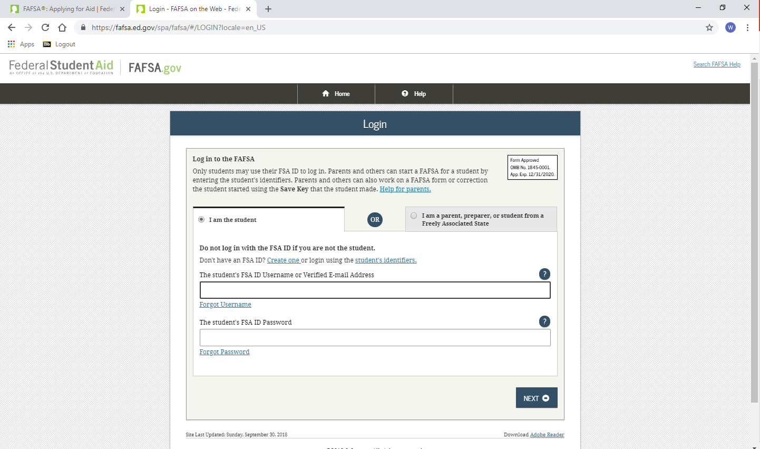
Sign in using FSA ID

Slide 23
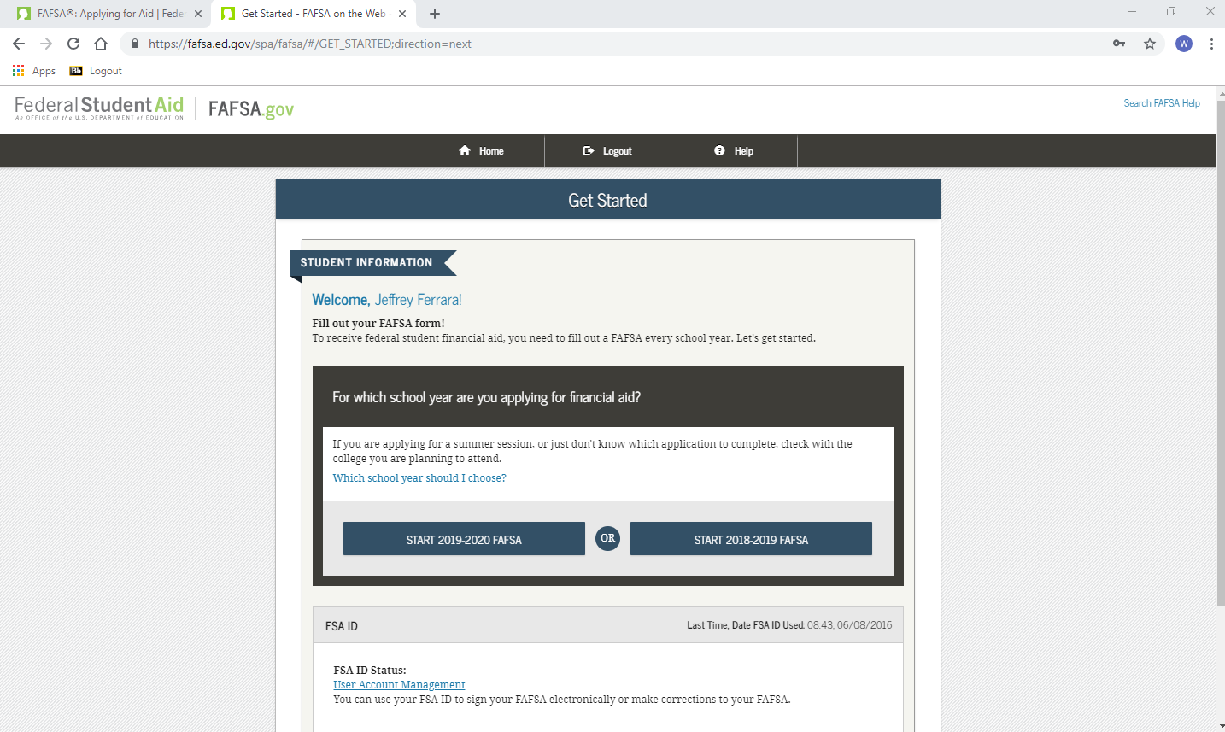
Make sure you choose the right Year

Slide 24
Seven Steps for Filing the FAFSA
Step One: Student Demographics
Name, social security number, birth date
Provide an email address
Indicate gender
Males have the opportunity to enroll in
Selective Service
For more information go to: www.sss.gov
Step Two: School Selection
Enter FAFSA codes – up to 10 colleges
Indicate housing status while in college

Slide 25
Seven Steps for Filing the FAFSA
Step Three: Dependency Status
Generally Dependent if under age 24
Independent if:
Married
A graduate student
Serving in the U.S. military or a veteran
Supporting children or other dependents
Has a court appointed legal guardian
Has been determined homeless or at risk of
being homeless
Step Four: Parent Demographics
Name, social security numbers, birth dates
Marital status
If Separation or Divorce–current family unit (parent student lives with the most)
Step Five: Financial Information
Use 2017 tax returns for 2019-20
IRS Data Retrieval

Slide 26
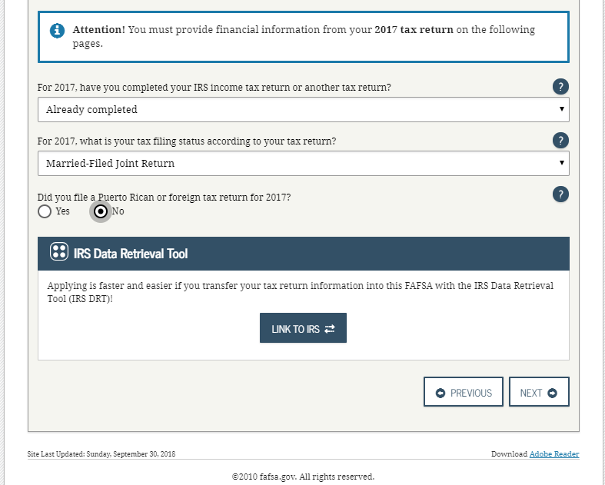

Slide 27
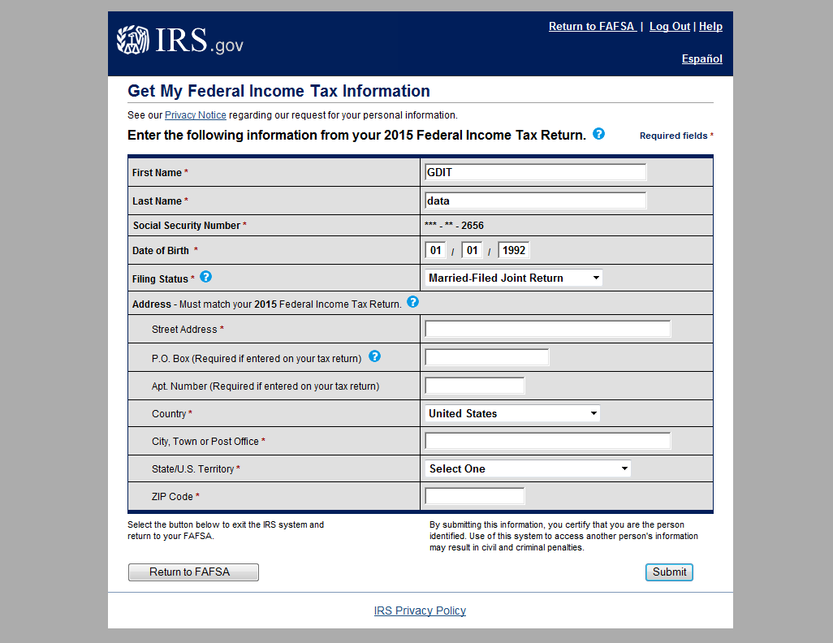
These fields are pre-filled based on FAFSA responses

Slide 28
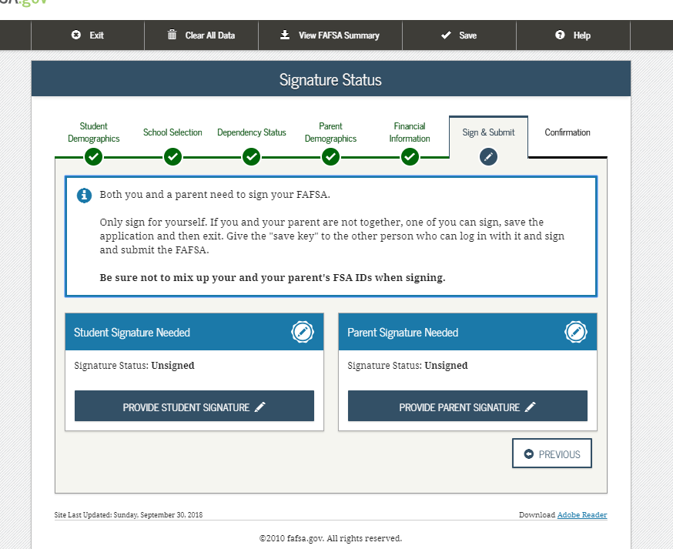
Seven Steps for Filing the FAFSA
Step Six: Sign and Submit using the FSA ID
Sign electronically

Slide 29
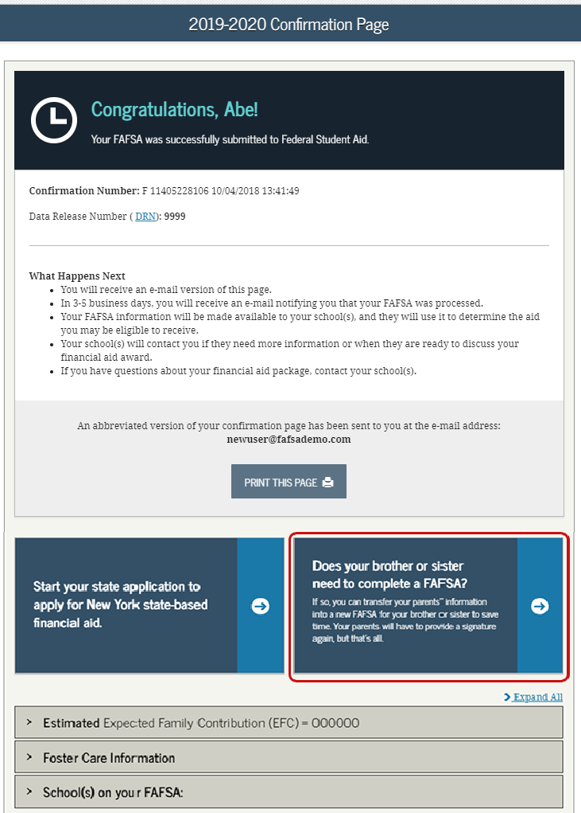
Seven Steps for FAFSA
Step Seven: Confirmation

Slide 30
How To Apply
4. Complete TAP Online
https://www.tap.hesc.ny.gov/totw/
After completing FAFSA online, from the confirmation page, link to the TAP-on-the-Web. https://www.tap.hesc.ny.gov/totw
Establish student TAP PIN.
Must re-apply each academic year.

Slide 31
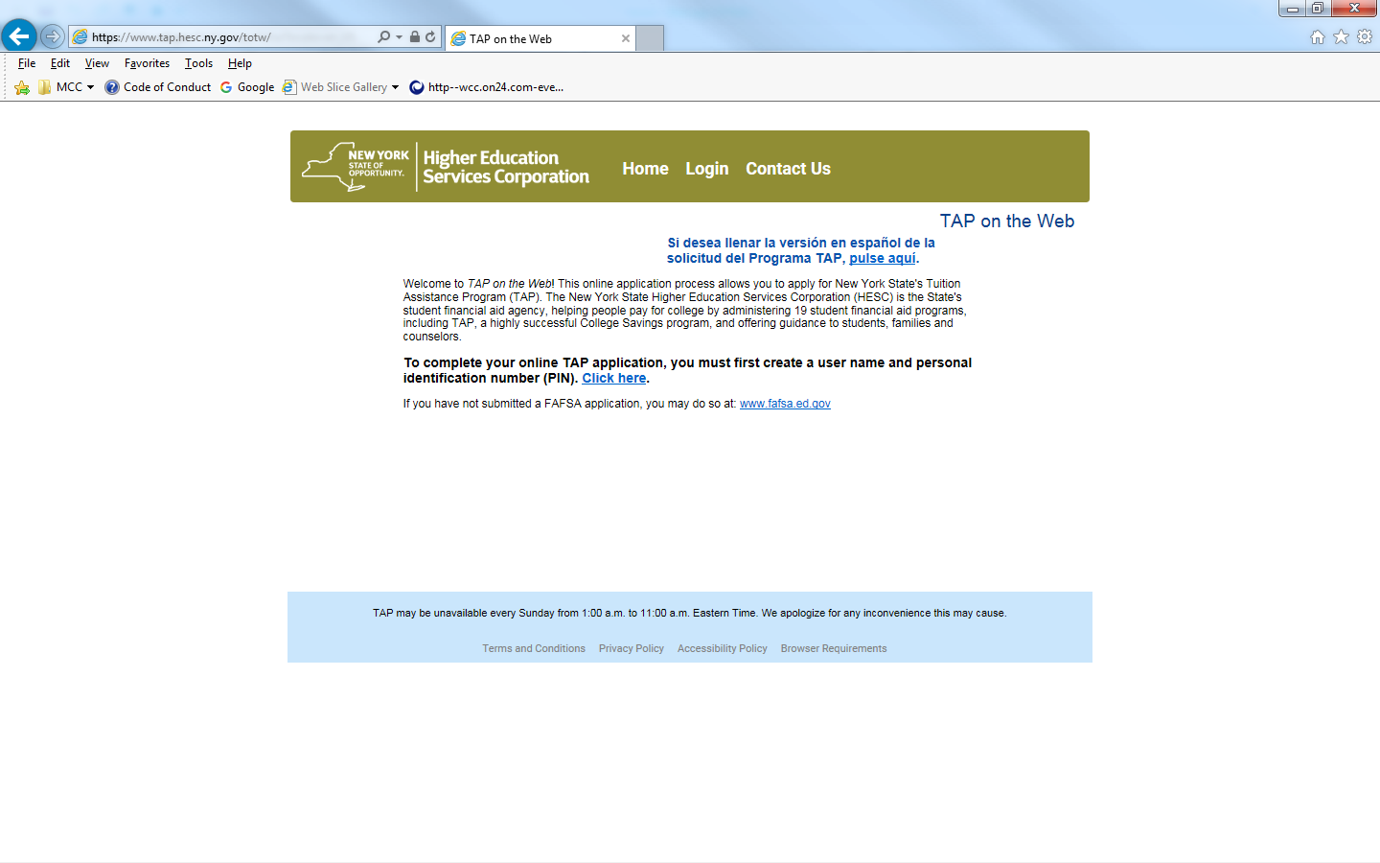

Slide 32
5. Apply for Excelsior
To be notified when the application becomes available (likely February of 2019)
Sign up for the HESC alert at www.hesc.ny.gov/excelsior
Same application site as TAP

Slide 33
6. Watch for SAR & Communicate with Financial Aid Office
SAR will be available in 3-5 days
EFC is printed on upper right corner
Make sure all information is correct
Corrections-on-the-Web at www.fafsa.ed.gov OR talk to school(s)

Slide 34
When To Apply for 2019-20
FSA ID – Now or Near Future
Scholarship Searches – Now/Ongoing
FAFSA – Anytime after October 1, 2018; Before school deadline.
Check school websites
TAP – After the FAFSA.
Excelsior – when available
Other Forms??

Slide 35
Other Forms
Check with College:
CSS Profile – limited number of highly competitive school might use this additional form
http://css.collegeboard.org/
After October 1, 2018 for the 2019-20 year
College might require scholarship application
Application for other program:
EOP at Public College or HEOP at Private College – NY State Colleges
Provides access and resources for students who otherwise might not meet qualifications for the college

Slide 36
Delays in Processing
FSA ID Set Up/Signatures
Errors on the FAFSA
Misspelled names or incorrect date of birth or social security numbers.
Citizenship
Selective Service Registration – www.sss.gov
Males 18-25 can register right on the FAFSA even if 17 when you file FAFSA

Slide 37
What Happens After I Apply
Student notified when FAFSA is processed.
Sent via e-mail; parent gets e-mail as well
Student Aid Report (SAR); Determines Estimated Family Contribution (EFC)
Schools receive your data from FAFSA
May ask for follow up information.
determine your awards.
Federal and state grants – set by your applications.
School based aid and loans (up to loan limit) – based on the schools financial aid packaging policies.

Slide 38
What Happens After I Apply
TAP Award notifications are sent by the Higher Education Services Corporation (HESC).
Official TAP award notifications are sent out after NYS budget is passed.
Schools will estimate TAP awards on their award letters.
If you have done all required steps, award letters come out from schools in winter.

Slide 40
Strategies - Preparation
Keep Organized – be ready to follow up
System to remember FSA ID; folder for documents; etc…
Meet Deadlines!
Parent/Student Communication
E-mail checking
Compare – Make Charts?
Required forms and dates for each school

Slide 41
Strategies - Financing
Payment Plan as opposed to Alternative Financing or Parent Loan.
Savings – 529 plans
Appeals based on unusual circumstances or changes in situation AFTER FAFSA is filed.
Is 2018 or 2019 income going to be lower than 2017?
Limit Borrowing; compare net costs
Reduce costs – books and supplies; complete on time; set budgets

Slide 42
Questions
Jerome St. Croix, Director, Financial Aid Compliance
Monroe Community College
jstcroix@monroecc.edu
(585) 685-6113
Jeffrey Ferrara, Financial Aid Advisor
Monroe Community College
jferrara16@monroecc.edu
585-292-2285

